Slide 1
WIRELESS SENSOR NETWORKS
WSNs are collections of compact-size ,relatively inexpensive computational nodes that measure local environmental conditions or other parameters and forward such information to a central point for appropriate processing
WSNs nodes(WNs) can sense the environment ,can communicate with neighbouring nodes, and in many cases, perform basic computations on the data being collected.

Slide 2
Sensor networks
Sensor networks is an interdisciplinary research area that draws on contributions from signal processing, networking and protocols, databases and information management, distributed algorithms, and embedded systems and architecture

Slide 3
Key Definitions
Sensor: A transducer that converts a physical phenomenon such as heat, light, sound, or motion into electrical or other signals that may be further manipulated by other apparatus.
Sensor node: A basic unit in a sensor network, with on-board sensors, processor, memory, wireless modem, and power supply. It is often abbreviated as node. When a node has only a single sensor on board, the node is sometimes also referred to as a sensor, creating some confusion.

Slide 4
Key Definitions
Network topology: A connectivity graph where nodes are sensor nodes and edges are communication links. In a wireless network, the link represents a one-hop connection, and the neighbors of a node are those within the radio range of the node.
Routing: The process of determining a network path from a packet source node to its destination.

Slide 5
Key Definitions
Date-centric: Approaches that name, route, or access a piece of data via properties, such as physical location, that are external to a communication network. This is to be contrasted with address-centric approaches which use logical properties of nodes related to the network structure.
Geographic routing: Routing of data based on geographical attributes such as locations or regions. This is an example of date-centric networking.

Slide 6
Key Definitions
In-network: A style of processing in which the data is processed and combined near where the data is generated.
Collaborative processing: Sensors cooperatively processing data from multiple sources in order to serve a high-level task. This typically requires communication among a set of nodes
State: A snapshot about a physical environment (e.g., the number of signal sources, their locations or spatial extent, speed of movement), or a snapshot of the system itself (e.g., the network state).

Slide 7
Key Definitions
Resource: Resources include sensors, communication links, processors, on-board memory, and node energy reserves. Resource allocation assigns resources to tasks, typically optimizing some performance objective.
Sensor tasking: The assignment of sensors to a particular task and the control of sensor state (e.g., on/off, pan/tilt) for accomplishing the task.
Node services: Services such as time synchronization and node localization that enable applications to discover properties of a node and the nodes to organize themselves into a useful network.

Slide 8
Key Definitions
Data storage: Sensor information is stored, indexed, and accessed by applications. Storage may be local to the node where the data is generated, load-balanced across a network, or anchored at a few points (warehouses).
Embedded operating system (OS): The run-time system support for sensor network applications. An embedded OS typically provides an abstraction of system resources and a set of utilities.
System performance goal: The abstract characterization of system properties. Examples include scalability, robustness, and network longevity, each of which may be measured by a set of evaluation metrics.

Slide 9
Key Definitions
Evaluation metric: A measurable quantity that describes how well the system is performing on some absolute scale. Examples include packet loss (system), network dwell time (system), track loss (application), false alarm rate (application), probability of correct association (application), location error (application), or processing latency (application/system). An evaluation method is a process for comparing the value of applying the metrics on an experimental system with that of some other benchmark system.

Slide 10
ADVANTAGES OF SENSOR NETWORKS
Networked sensing offers unique advantages over traditional centralized approaches.
Dense networks of distributed communicating sensors can improve signal-to-noise ratio (SNR) by reducing average distances from sensor to source of signal, or target.
Increased energy efficiency in communications is enabled by the multihop topology of the network
the greatest advantages of networked sensing are in improved robustness and scalability.
A decentralized sensing system is inherently more robust against individual sensor node or link failures, because of redundancy in the network

Slide 11

ADVANTAGES OF SENSOR NETWORKS
Energy Advantage :
Because of the unique attenuation characteristics of radio-frequency (RF) signals, a multihop RF network provides a significant energy saving over a single-hop network for the same distance.
Consider the following simple example of an N-hop network. Assume the overall distance for transmission is Nr, where r is the one-hop distance. The minimum receiving power at a node for a given transmission error rate is Preceive, and the power at a transmission node is Psend. Then,

Slide 12
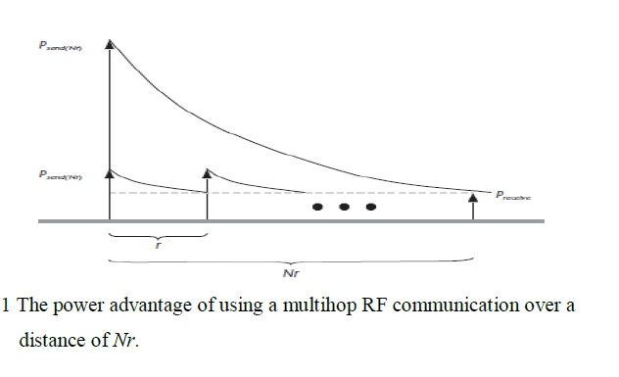
ADVANTAGES OF SENSOR NETWORKS

Slide 13

ADVANTAGES OF SENSOR NETWORKS
Detection Advantage : Each sensor has a finite sensing range, determined by the noise floor at the sensor. A denser sensor field improves the odds of detecting a signal source within the range. Once a signal source is inside the sensing range of a sensor, further increasing the sensor density decreases the average distance from a sensor to the signal source, hence improving the signal-to-noise ratio (SNR).
The SNR is given by

Slide 14
UNIQUE CONSTRAINTS AND CHALLENGES
on-board battery power and limited network communication bandwidth
Sensor networks extend the existing Internet deep into the physical environment. The resulting new network is orders of magnitude more expansive and dynamic than the current TCP/IP network and is creating entirely new types of traffic that are quite different from what one finds on the Internet now
Limited hardware
Limited support for networking
Limited support for software development:

Slide 15
APPLICATIONS
Military applications: Sensor nodes can be spread across a battlefield or enemy area and be programmed to track and monitor enemy troop movements or movement of terrorists and can be used to locate their exact positions.

Slide 16
APPLICATIONS
Environmental applications: Sensor networks are being increasingly used for environmental concerns. Examples include tracking the nesting habits of seabirds by monitoring a large geographic region with human presence, or attaching the sensors directly to large mammals to monitor their behavior.

Slide 17
APPLICATIONS
Medical applications: WSNs can be used in medical applications by using the sensor node as a device that can reside on or within the human body and perform tasks that are currently done by costly machines

Slide 18
APPLICATIONS
Industrial applications: For use in industrial applications, low-cost sensor nodes could be attached to equipment to monitor performance
Urban applications: WSNs can be used for various urban applications like transportation and traffic systems, auto-identification by driving license, parking availability, security monitors in shopping malls, parking garages, city streets and home security

Slide 19
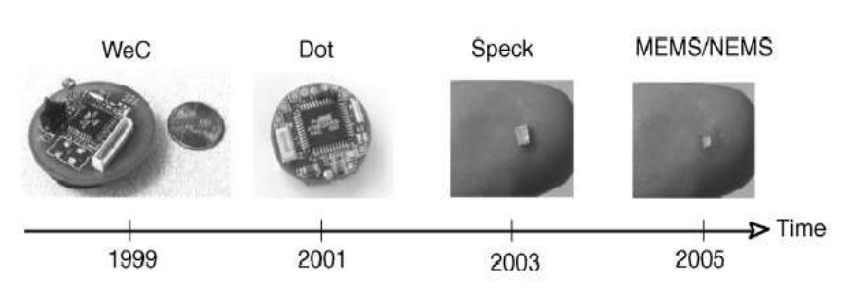
ENABLING TECHNOLOGIES FOR WIRELESS SENSOR NETWORKS
First and foremost among these technologies is the miniaturization of hardware.
Reduced chip size and improved energy efficiency is accompanied by reduced cost, which is necessary to make redundant deployment of nodes affordable.

Slide 20
ENABLING TECHNOLOGIES FOR WIRELESS SENSOR NETWORKS
This requires, depending on application, high capacity batteries that last for long times, that is, have only a negligible self-discharge rate, and that can efficiently provide small amounts of current. Ideally, a sensor node also has a device for energy scavenging, recharging the battery with energy gathered from the environment – solar cells or vibration-based power generation are conceivable options.

Slide 21
ENABLING TECHNOLOGIES FOR WIRELESS SENSOR NETWORKS
This software architecture on a single node has to be extended to a network architecture, where the division of tasks between nodes

Slide 22
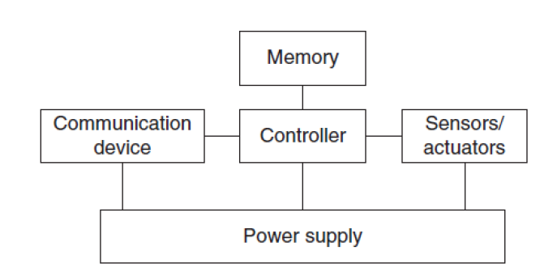
Single node architecture

Slide 23
Single node architecture
Controller A controller to process all the relevant data, capable of executing arbitrary code.
Memory Some memory to store programs and intermediate data; usually, different types of memory are used for programs and data.
Sensors and actuators The actual interface to the physical world: devices that can observe or control physical parameters of the environment.
Communication Turning nodes into a network requires a device for sending and receiving information over a wireless channel.
Power supply As usually no tethered power supply is available, some form of batteries are necessary
to provide energy. Sometimes, some form of recharging by obtaining energy from the environment is available as well (e.g. solar cells).

Slide 24
Controller
The controller is the core of a wireless sensor node. It collects data from the sensors, processes this data, decides when and where to send it, receives data from other sensor nodes, and decides on the actuator’s behavior.
It has to execute various programs, ranging from time-critical signal processing and communication protocols to application programs; it is the Central Processing Unit (CPU) of the node.
These processors are highly overpowered, and their energy consumption is excessive. But simpler processors do exist, specifically geared toward usage in embedded systems. These processors are commonly referred as microcontrollers

Slide 25
Some of the key characteristics why these microcontrollers are particularly suited to embedded systems are their flexibility in connecting with other devices (like sensors), their instruction set amenable to time-critical signal processing, and their typically low power consumption; they are also convenient in that they often have memory built in

Slide 26
Some examples for microcontrollers :
Intel StrongARM The Intel StrongARM is, in WSN terms, a fairly high-end processor as it is mostly geared toward handheld devices like PDAs. The SA-1100 model has a 32-bit Reduced Instruction Set Computer (RISC) core, running at up to 206 MHz.
Texas Instruments MSP 430 Texas Instrument provides an entire family of microcontrollers under the family designation MSP 430. Unlike the StrongARM, it is explicitly intended for embedded applications
Atmel ATmega The Atmel ATmega 128L [28] is an 8-bit microcontroller, also intended for usage in embedded applications and equipped with relevant external interfaces for common peripherals.

Slide 27
Memory
The memory component is fairly straightforward. Evidently, there is a need for Random Access Memory (RAM) to store intermediate sensor readings, packets from other nodes, and so on. While RAM is fast, its main disadvantage is that it loses its content if power supply is interrupted.
Program code can be stored in Read-Only Memory (ROM) or, more typically, in Electrically Erasable Programmable Read-Only Memory (EEPROM) or flash memory (the later being similar to EEPROM but allowing data to be erased or written in blocks instead of only a byte at a time).

Slide 28
Communication device
Choice of transmission medium :
The communication device is used to exchange data between individual nodes
The case of wireless communication is considerably more interesting. The first choice to make is that of the transmission medium
the usual choices include radio frequencies, optical communication, and ultrasound; other media like magnetic inductance are only used in very specific cases
Of these choices, Radio Frequency (RF)-based communication is by far the most relevant one as it best fits the requirements of most WSN applications

Slide 29
Contd..
It provides relatively long range and high data rates, acceptable error rates at reasonable energy expenditure, and does not require line of sight between sender and receiver.
Transceivers :
For actual communication, both a transmitter and a receiver are required in a sensor node. The essential task is to convert a bit stream coming from a microcontroller (or a sequence of bytes or frames) and convert them to and from radio waves
Usually, half-duplex operation is realized since transmitting and receiving at the same time on a wireless medium is impractical in most cases

Slide 30
Transceiver tasks and characteristics
Service to upper layer A receiver has to offer certain services to the upper layers, most notably to the Medium Access Control (MAC) layer. Sometimes, this service is packet oriented;
sometimes, a transceiver only provides a byte interface or even only a bit interface to the microcontroller.

Slide 31
Power consumption and energy efficiency
The simplest interpretation of energy efficiency is the energy required to transmit and receive a single bit. Also, to be suitable for use in WSNs, transceivers should be switchable between different states, for example, active and sleeping.
The idle power consumption in each of these states and during switching between them is very important .

Slide 32
Carrier frequency and multiple channels
Transceivers are available for different carrier frequencies;
evidently, it must match application requirements and regulatory restrictions. It is often useful if the transceiver provides several carrier frequencies (“channels”) to choose from, helping to alleviate some congestion problems in dense networks.

Slide 33
State change times and energy
A transceiver can operate in different modes: sending or receiving, use different channels, or be in different power-safe states. In any case, the time and the energy required to change between two such states are important figures of merit. The turnaround time between sending and receiving, for example, is important for various medium access protocols

Slide 34
Data rates
Carrier frequency and used bandwidth together with modulation and coding determine the gross data rate. Typical values are a few tens of kilobits per second – considerably less than in broadband wireless communication, but usually sufficient for WSNs. Different data rates can be achieved, for example, by using different modulations or changing the symbol rate.

Slide 35
Modulations
The transceivers typically support one or several of on/off-keying, ASK, FSK, or similar modulations. If several modulations are available, it is convenient for experiments if they are selectable at runtime even though, for real deployment, dynamic switching between modulations is not one of the most discussed options

Slide 36
Coding: Some transceivers allow various coding schemes to be selected.
Transmission power: control Some transceivers can directly provide control over the transmission power to be used; some require some external circuitry for that purpose. Usually, only a discrete number of power levels are available from which the actual transmission power can be chosen. Maximum output power is usually determined by regulations.

Slide 37
Noise figure: The noise figure NF of an element is defined as the ratio of the Signal-to-Noise Ratio (SNR) ratio SNRI at the input of the element to the SNR ratio SNRO at the element’s output
Gain :The gain is the ratio of the output signal power to the input signal power and is typically given in dB. Amplifiers with high gain are desirable to achieve good energy efficiency.

Slide 38
Power efficiency: The efficiency of the radio front end is given as the ratio of the radiated power to the overall power consumed by the front end; for a power amplifier, the efficiency describes the ratio of the output signal’s power to the power consumed by the overall power amplifier.

Slide 39
Receiver sensitivity: The receiver sensitivity (given in dBm) specifies the minimum signal power at the receiver needed to achieve a prescribed Eb/N0 or a prescribed bit/packet error rate. Better sensitivity levels extend the possible range of a system

Slide 40
Range: While intuitively the range of a transmitter is clear, a formal definition requires some care. The range is considered in absence of interference; it evidently depends on the maximum transmission power, on the antenna characteristics, on the attenuation caused by the environment, which in turn depends on the used carrier frequency, on the modulation/coding scheme that is used, and on the bit error rate that one is willing to accept at the receiver
It also depends on the quality of the receiver, essentially captured by its sensitivity. Typical values are difficult to give here, but prototypes or products with ranges between a few meters and several hundreds of meters are available.

Slide 41
Blocking performance: The blocking performance of a receiver is its achieved bit error rate in the presence of an interferer
An important special case is an adjacent channel interferer that transmits on neighbouring frequencies. The adjacent channel suppression describes a transceiver’s capability to filter out signals from adjacent frequency bands (and thus to reduce adjacent channel interference) has a direct impact on the observed Signal to Interference and Noise Ratio (SINR).

Slide 42
Out of band emission: The inverse to adjacent channel suppression is the out of band emission of a transmitter. To limit disturbance of other systems, or of the WSN itself in a multichannel setup, the transmitter should produce as little as possible of transmission power outside of its prescribed bandwidth, centered around the carrier frequency

Slide 43
Carrier sense and RSSI: In many medium access control protocols, sensing whether the wireless channel, the carrier, is busy (another node is transmitting) is a critical information. The receiver has to be able to provide that information.
The received energy is above threshold; however, the underlying signal does not need to comply with the modulation and spectral characteristics.
A carrier has been detected, that is, some signal which complies with the modulation.
Carrier detected and energy is present.
Also, the signal strength at which an incoming data packet has been received can provide useful information (e.g. a rough estimate about the distance from the transmitter assuming the transmission power is known); a receiver has to provide this information in the Received Signal Strength Indicator (RSSI).

Slide 44
Frequency stability: The frequency stability denotes the degree of variation from nominal center frequencies when environmental conditions of oscillators like temperature or pressure change.
In extreme cases, poor frequency stability can break down communication links, for example, when one node is placed in sunlight whereas its neighbor is currently in the shade.
Voltage range :Transceivers should operate reliably over a range of supply voltages. Otherwise, inefficient voltage stabilization circuitry is required

Slide 45
Transceiver structure
A fairly common structure of transceivers is into the Radio Frequency (RF) front end and the baseband part:
the radio frequency front end performs analog signal processing in the actual radio frequency band, whereas
the baseband processor performs all signal processing in the digital domain and communicates with a sensor node’s processor or other digital circuitry

Slide 46
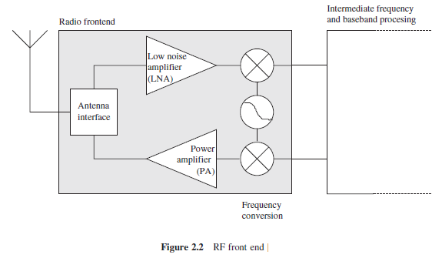

Slide 47
Some important elements of an RF front ends architecture are
The Power Amplifier (PA) accepts upconverted signals from the IF or baseband part and amplifies them for transmission over the antenna.
The Low Noise Amplifier (LNA) amplifies incoming signals up to levels suitable for further processing without significantly reducing the SNR . The range of powers of the incoming signals varies from very weak signals from nodes close to the reception boundary to strong signals from nearby nodes; this range can be up to 100 dB. Without management actions, the LNA is active all the time and can consume a significant fraction of the transceiver’s energy.
Elements like local oscillators or voltage-controlled oscillators and mixers are used for frequency
conversion from the RF spectrum to intermediate frequencies or to the baseband

Slide 48
Transmit: In the transmit state, the transmit part of the transceiver is active and the antenna radiates energy.
Receive: In the receive state the receive part is active.
Idle: A transceiver that is ready to receive but is not currently receiving anything is said to be in an idle state. In this idle state, many parts of the receive circuitry are active, and others can be switched off.
Sleep: In the sleep state, significant parts of the transceiver are switched off

Slide 49
Sensors and actuators
Sensors can be roughly categorized into three categories
Passive, omnidirectional sensors :
sensors can measure a physical quantity at the point of the sensor node without actually manipulating the environment by active probing – in this sense, they are passive.
Moreover, some of these sensors actually are self-powered in the sense that they obtain the energy they need from the environment – energy is only needed to amplify their analog signal
Typical examples for such sensors include thermometer, light sensors, vibration, microphones, humidity, mechanical stress or tension in materials, chemical sensors sensitive for given substances, smoke detectors, air pressure, and so on.

Slide 50
Passive, narrow-beam sensors: These sensors are passive as well, but have a well-defined notion of direction of measurement. A typical example is a camera, which can “take measurements” in a given direction, but has to be rotated if need be.
Active sensors: This last group of sensors actively probes the environment, for example, a sonar or radar sensor or some types of seismic sensors, which generate shock waves by small explosions.

Slide 51
Power supply of sensor nodes
For untethered wireless sensor nodes, the power supply is a crucial system component. There are essentially two aspects: First, storing energy and providing power in the required form; second, attempting to replenish consumed energy by “scavenging” it from some node-external power source
over time.
Storing power is conventionally done using batteries. As a rough orientation, a normal AA battery stores about 2.2–2.5 Ah at 1.5 V. Battery design is a science and industry in itself, and energy scavenging has attracted a lot of attention in research.

Slide 52
Storing energy: Batteries
The power source of a sensor node is a battery, either non rechargeable (“primary batteries”) or, if an energy scavenging device is present on the node, also rechargeable (“secondary batteries”).
In some form or other, batteries are electro-chemical stores for energy – the chemicals being the main determining factor of battery technology.

Slide 53
Capacity They should have high capacity at a small weight, small volume, and low price. The main metric is energy per volume
Capacity under load They should withstand various usage patterns as a sensor node can consume quite different levels of power over time and actually draw high current in certain operation modes.
Self-discharge Their self-discharge should be low; they might also have to last for a long time (using certain technologies, batteries are operational only for a few months, irrespective of
whether power is drawn from them or not).
Efficient recharging Recharging should be efficient even at low and intermittently available recharge power; consequently, the battery should also not exhibit any “memory effect”.

Slide 54
Energy consumption of sensor nodes
As the previous section has shown, energy supply for a sensor node is at a premium: batteries have small capacity, and recharging by energy scavenging is complicated and volatile. Hence, the energy consumption of a sensor node must be tightly controlled.
The main consumers of energy are the controller, the radio front ends, to some degree the memory, and, depending on the type, the sensors.

Slide 55
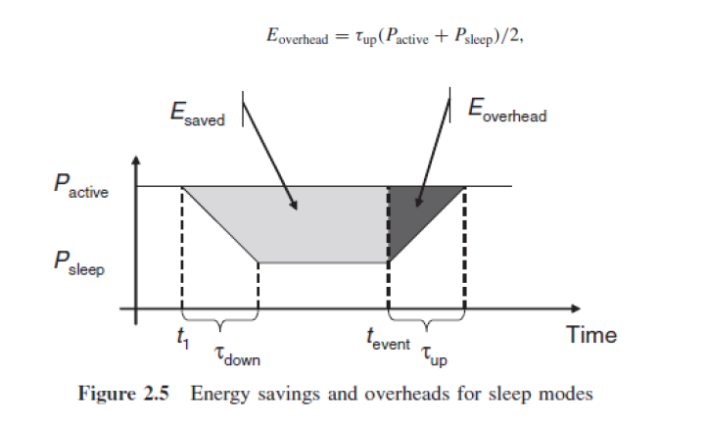

Slide 56
Network architecture
Types of source and sinks
A source is any entity in the network that can provide information, that is, typically a sensor node; it could also be an actuator node that provides feedback about an operation.
A sink, on the other hand, is the entity where information is required. There are essentially three options for a sink: it could belong to the sensor network as such and be just another sensor/actuator node or it could be an entity outside this network

Slide 57
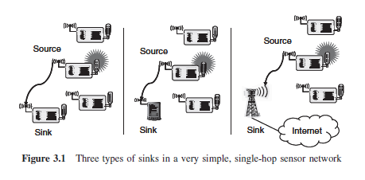
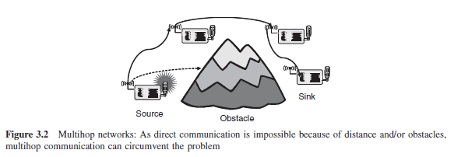
Single-hop versus multihop networks

Slide 58
Multiple sinks and sources
So far, only networks with a single source and a single sink have been illustrated. In many cases, there are multiple sources and/or multiple sinks present.
In the most challenging case, multiple sources should send information to multiple sinks, where either all or some of the information has to reach all or some of the sinks. Figure 3.3 illustrates these combinations.

Slide 59
